Slide 1
Estimating with PROBE II
Personal Software ProcessSM for Engineers: Part I

Slide 2
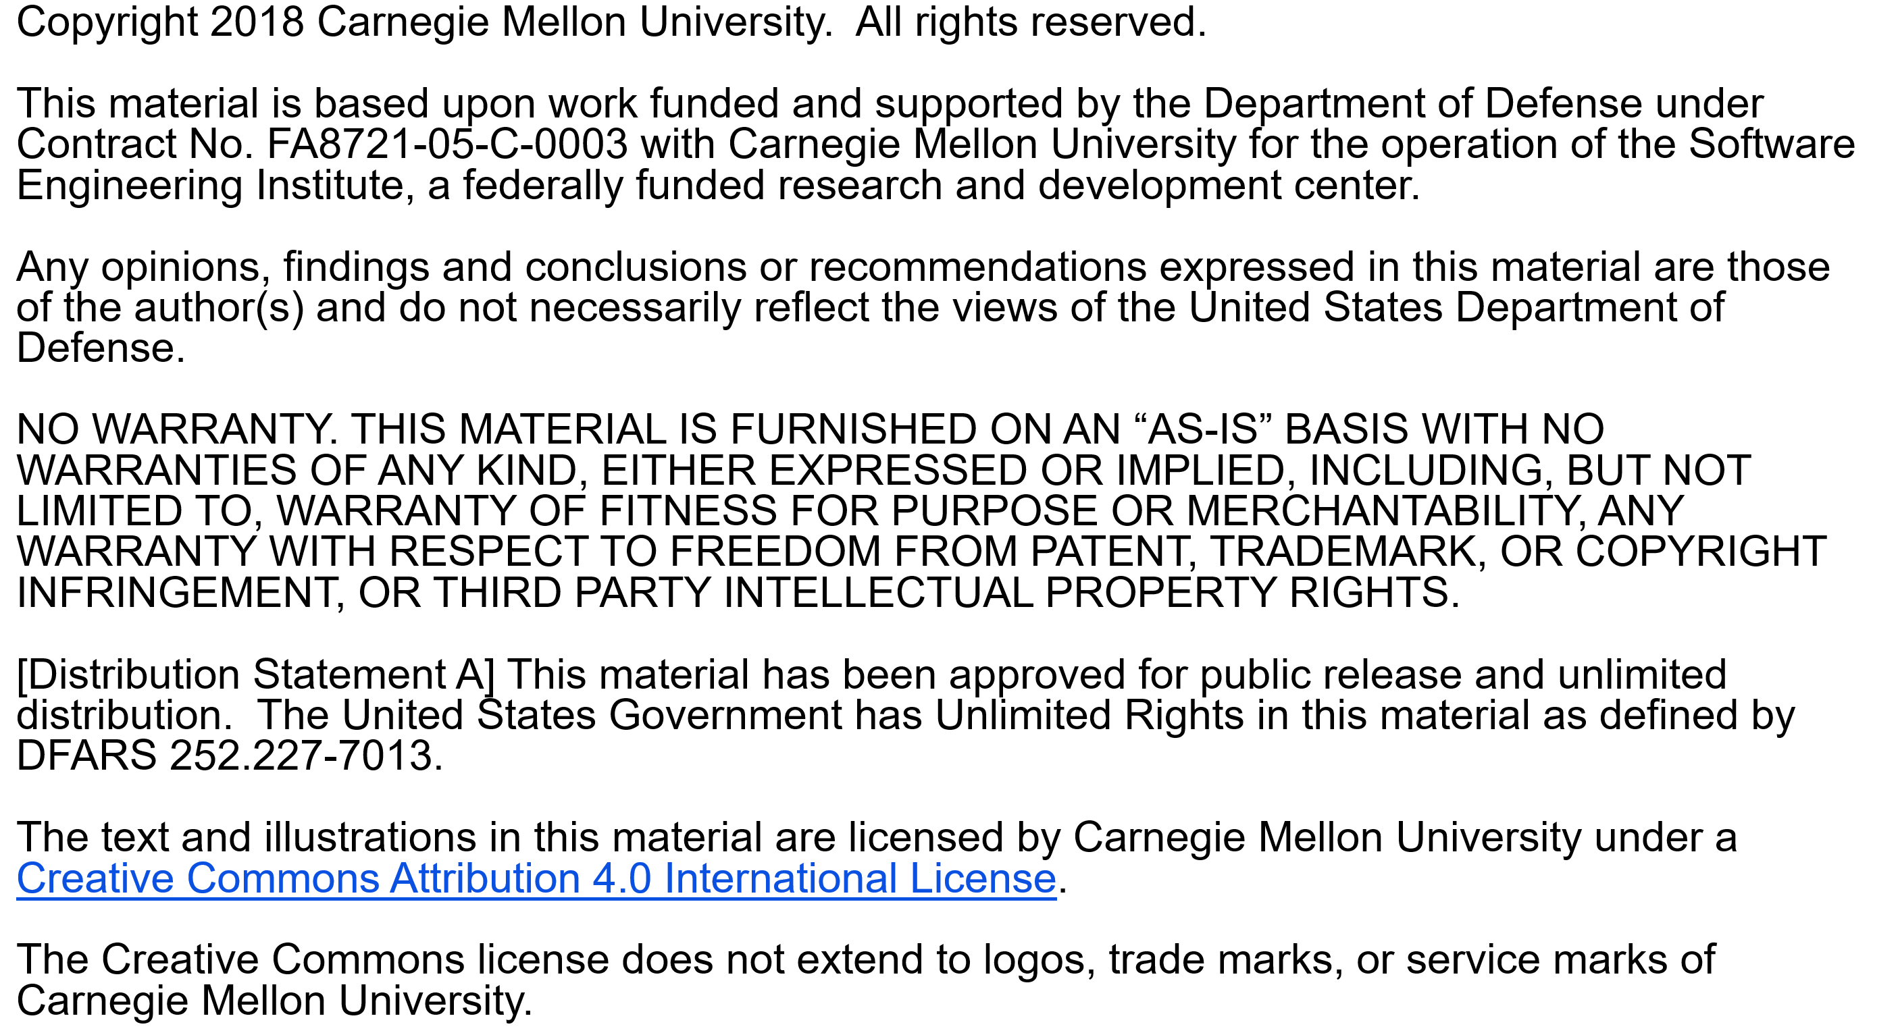

Slide 3
Copyright 2016 Carnegie Mellon University [Distribution Statement A] This material has been approved for public release and unlimited distribution. Please see Copyright notice for non-US Government use and distribution. This material is based upon work funded and supported by the Department of Defense under Contract No. FA8721-05-C-0003 with Carnegie Mellon University for the operation of the Software Engineering Institute, a federally funded research and development center. NO WARRANTY. THIS CARNEGIE MELLON UNIVERSITY AND SOFTWARE ENGINEERING INSTITUTE MATERIAL IS FURNISHED ON AN “AS-IS” BASIS. CARNEGIE MELLON UNIVERSITY MAKES NO WARRANTIES OF ANY KIND, EITHER EXPRESSED OR IMPLIED, AS TO ANY MATTER INCLUDING, BUT NOT LIMITED TO, WARRANTY OF FITNESS FOR PURPOSE OR MERCHANTABILITY, EXCLUSIVITY, OR RESULTS OBTAINED FROM USE OF THE MATERIAL. CARNEGIE MELLON UNIVERSITY DOES NOT MAKE ANY WARRANTY OF ANY KIND WITH RESPECT TO FREEDOM FROM PATENT, TRADEMARK, OR COPYRIGHT INFRINGEMENT. This material is distributed by the Software Engineering Institute (SEI) only to course attendees for their own individual study. Except for the U.S. government purposes described below, this material SHALL NOT be reproduced or used in any other manner without requesting formal permission from the Software Engineering Institute at permission@sei.cmu.edu. The U.S. Government's rights to use, modify, reproduce, release, perform, display, or disclose this material are restricted by the Rights in Technical Data-Noncommercial Items clauses (DFAR 252-227.7013 and DFAR 252-227.7013 Alternate I) contained in the above identified contract. Any reproduction of this material or portions thereof marked with this legend must also reproduce the disclaimers contained on this slide. Although the rights granted by contract do not require course attendance to use this material for U.S. Government purposes, the SEI recommends attendance to ensure proper understanding. Carnegie Mellon® is registered in the U.S. Patent and Trademark Office by Carnegie Mellon University. Personal Software ProcessSM, PSPSM, Team Software ProcessSM and TSPSM are service marks of Carnegie Mellon University. DM-0004310

Slide 4
Lecture Topics
Estimating with PROBE II
The prediction interval
Organizing proxy data
Estimating with limited data
Estimating accuracy
Estimating considerations

Slide 5
The Prediction Interval
Estimating with PROBE II
The prediction interval provides a likely range around the estimate.
A 70% prediction interval gives the range within which the actual size will likely fall 70% of the time.
The prediction interval is not a forecast, only an expectation.
It applies only if the estimate behaves like the historical data.
It is calculated from the same data used to calculate the regression parameters.

Slide 6
A Prediction Interval Example
Estimating with PROBE II
27 C++ programs

Slide 7
The Range Calculation
Estimating with PROBE II
The range defines the likely error around the projection within which the actual value is likely to fall.
Widely scattered data will have a wider range than closely bunched data.
The variables are
n - number of data points
σ - the standard deviation around the regression line
t(p, df)- the t distribution value for probability p (70%) and df (n-2) degrees of freedom
x - the data: k - the estimate, i - a data point, and avg - average of the data

Slide 8
The Standard Deviation Calculation
Estimating with PROBE II
The standard deviation measures the variability of the data around the regression line.
Widely scattered data will have a higher standard deviation than closely bunched data.
The standard deviation σ is the square root of the variance.

Slide 9
Calculate the Prediction Interval
Estimating with PROBE II
Calculate the prediction range for size and time for the example in lecture 3 (slides 42 and 43).
Calculate the upper (UPI) and lower (LPI) prediction intervals for size.
UPI = P + Range = 538 + 235 = 773 LOC
LPI = P - Range (or 0) = 538 - 235 = 303 LOC
Calculate the UPI and LPI prediction intervals for time.
UPI = Time + Range = 1186 +431 = 1617 min.
LPI = Time - Range (or 0) = 1186 - 431 = 755 min.

Slide 10
Organizing Proxy Data -1
Estimating with PROBE II
To make an estimate
break the planned product into parts
relate these planned parts to parts that you have already built
use the size of the previously-built parts to estimate the
sizes of the new parts
To do this, you need size ranges for the types of parts that you typically develop.
For each product type, you also need size ranges to help you to judge the sizes of the new parts.

Slide 11
Organizing Proxy Data -2
Estimating with PROBE II
To determine the size ranges, start with the part data.
Assume that you have the following data.
class A, three items (or methods), 39 total LOC
class B, five items, 127 total LOC
class C, two items, 64 total LOC
class D, three items, 28 total LOC
class E, one item, 12 LOC
class F, two items, 21 total LOC
The LOC per item is 13, 25.4, 32, 9.333, 12, 10.5.
The objective is define size ranges that approximate our intuitive feel for size.

Slide 12
Organizing Proxy Data -3
Estimating with PROBE II
To produce the size ranges, sort the data as follows.
The sorted LOC per item data: 9.333, 10.5, 12, 13, 25.4, 32.
Arrange these data as follows.
Pick the smallest item as very small: VS = 9.333.
Select the largest item as very large: VL = 32.
Pick the middle item as medium: M = 12 or 13.
For the large and small ranges, pick the midpoints between M and VS and M and VL: 10.9, and 22.25.
While these may be useful ranges, they are probably not stable.
That is, additional data points will likely result in substantial size-range adjustments.

Slide 13
Intuitive Size Ranges -1
Estimating with PROBE II
In judging size, our intuition is generally based on a normal distribution.
That is, we think of something as of average size if most such items are about that same size.
We consider something to be very large if it is larger than almost all items in its category.
When items are distributed this way, it is called a normal distribution.
With normally distributed data, the ranges should remain reasonably stable with the addition of new data points.

Slide 14
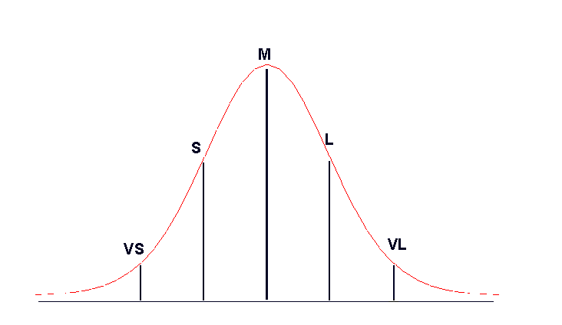
Intuitive Size Ranges -2
Estimating with PROBE II
A normal distribution

Slide 15
Intuitive Size Ranges -3
Estimating with PROBE II
With a large volume of data, you could calculate the mean and standard deviation of that data.
For the size ranges
Medium would be the mean value.
Large would be mean plus one standard deviation.
Small would be mean minus one standard deviation.
Very large would be mean plus two standard deviations.
Very small would be mean minus two standard deviations.
This method would provide suitably intuitive size ranges if the data were normally distributed.

Slide 16
The Distribution of Size Data
Estimating with PROBE II
Program size data are not normally distributed.
many small values
a few large values
no negative values
With size data, the mean minus one or two standard deviations often gives negative size values.
The common strategy for dealing with such distributions is to treat it as a log-normal distribution.

Slide 17
A Log-Normal Distribution
Estimating with PROBE II

Slide 18
The Log-Normal Distribution
Estimating with PROBE II
To normalize size data, do the following:
Take the natural logarithm of the data.
Determine the mean and standard deviation of the log data.
Calculate the average, large, very large, small, and very small values for the log data.
Take the inverse log of the ranges to obtain the range size values.
This procedure will generally produce useful size ranges.

Slide 19
Organizing Proxy Data -4
Estimating with PROBE II
A mathematically precise way to determine the proxy size ranges is described in the text (pages 78-79).
This simple way to determine these size ranges will work when you have lots of data. Otherwise, it can cause underestimates.
Comparative estimating ranges

Slide 20
Estimating with Limited Data -1
Estimating with PROBE II
Even after using PSP for many projects, you will have to make estimates with limited data when you
work in a new environment
use new tools or languages
change your process
do unfamiliar tasks
Since estimates made with data are more accurate than guesses, use data whenever you can.
Use the data carefully since improper use can lead to serious errors.

Slide 21
Estimating with Limited Data -2
Estimating with PROBE II
Depending on the quality of your data, select one of the four PROBE estimating methods.
Method
A | regression with estimated proxy size
B | regression with plan added and modified size
C | the averaging method
D | engineering judgment
To use regression method A or B, you need
a reasonable amount of historical data
data that correlate
reasonable β₀ and β₁ parameter values

Slide 22
Method A (Regression): Estimated Proxy Size
Estimating with PROBE II
Method A uses the relationship between estimated proxy size (E) and actual
added and modified size
development time
The criteria for using this method are
three or more data points that correlate (R2 > 0.5)
reasonable regression parameters (table 6.6 on pg. 96)
completion of at least three exercises with PSP1 or higher

Slide 23
Method B (Regression): Plan Added and Modified Size
Estimating with PROBE II
Method B uses the relationship between plan added and modified size and
actual added and modified size
actual development time
The criteria for using this method are
three or more data points that correlate (R2 >0.5)
reasonable regression parameters (table 6.6 on pg. 96)
completion of at least three exercises with PSP0.1 or higher

Slide 24
Method C: Averaging
Estimating with PROBE II
Method C uses a ratio to adjust size or time based on historical averages.
The averaging method is easy to use and requires only one data point.
Averages assume that there is no fixed overhead.
The averaging method is described in the PROBE script in table 6.6 on page 96.

Slide 25
Method D: Engineering Judgment
Estimating with PROBE II
Use method D when you don’t have historical data. Use judgment to
project the added and modified size from estimated part size
estimate development time
Use method D when you cannot use methods A, B, or C.

Slide 26
Estimating Accuracy
Estimating with PROBE II
Planning is a skill that must be developed.
The PSP helps to build planning skills.
Even simple plans are subject to error.
unforeseen events
unexpected complications
better design ideas
just plain mistakes
The best strategy is to plan in detail.
Identify the recognized tasks.
Make estimates based on similar experiences.
Make judgments on the rest.

Slide 27
Combining Estimates
Estimating with PROBE II
To combine multiple estimates made by a single developer
add the estimates for the separate parts
make one linear regression calculation
calculate one set of prediction intervals
Multiple developers can combine independently-made estimates by
making separate linear regression projections
adding the projected sizes and times
adding the squares of the individual ranges and taking the square root to get the prediction interval

Slide 28
Estimating Error: Example
Estimating with PROBE II
When estimating in parts, the total error will be less than the sum of the part errors.
Errors tend to balance out.
This assumes no common bias.
For a 1000-hour job with estimating accuracy of ± 50%, the estimate range is from 500 to 1500 hours.
If the estimate is independently made in 25 parts, each with 50% error, the
total would be 1000 hours, as before
estimate range would be from 900 to 1100 hours

Slide 29
Combining Individual Errors
Estimating with PROBE II
To combine independently-made estimates
Add the estimated values.
Combine the variances (squares) of the errors.
With 25 estimates for a 1000-hour job
Each estimate averages 40 hours.
The standard deviation is 50%, or 20 hours.
The variance for each estimate is 400 hours.
The variances add up to 10,000 hours.
The combined standard deviation is the square root of the sum of the variances, or 100 hours.
The estimate range is 900 to 1100 hours.

Slide 30
Class Exercise -1
Estimating with PROBE II
Start with three estimates.
A = 45 hours, + or - 10
B = 18 hours, + or - 5
C = 85 hours, + or - 25
What is the combined estimate?

Slide 31
Class Exercise -2
Estimating with PROBE II
Start with three estimates.
A = 45 hours, + or - 10
B = 18 hours, + or - 5
C = 85 hours, + or - 25
What is the combined estimate?
total = 45 + 18 + 85 = 148 hours
What is the combined estimate range?

Slide 32
Class Exercise -3
Estimating with PROBE II
Start with three estimates.
A = 45 hours, + or - 10
B = 18 hours, + or - 5
C = 85 hours, + or - 25
What is the combined estimate?
total = 45 + 18 + 85 = 148 hours
What is the combined estimate range?
variance = 100 + 25 + 625 = 750
range = square root of variance = 27.4 hours
What is the combined UPI and LPI?

Slide 33
Class Exercise -4
Estimating with PROBE II
Start with three estimates.
A = 45 hours, + or - 10
B = 18 hours, + or - 5
C = 85 hours, + or - 25
What is the combined estimate?
total = 45 + 18 + 85 = 148 hours
What is the combined estimate range?
variance = 100 + 25 + 625 = 750
range = square root of variance = 27.4 hours
What is the combined UPI and LPI?
UPI = 148 + 27.4 = 175.4 hours
LPI = 148 – 27.4 = 120.6 hours

Slide 34
Using Multiple Proxies
Estimating with PROBE II
With size/hour data for several proxies
estimate each as before
combine the total estimates and prediction intervals as just described
Use multiple regression if
there is a correlation between development time and each proxy
the proxies do not have separate size/hour data
Multiple regression is covered in exercise hints for the final PSP exercise.

Slide 35
Estimating Considerations
Estimating with PROBE II
While the PROBE method can provide accurate estimates, improper use of data can lead to serious errors.
One extreme point can give a high correlation even when the remaining data are poorly correlated.
Similarly, extreme points can lead to erroneous β₀ and β₁ values, even with a high correlation.

Slide 36
Correlation with Grouped Data
Estimating with PROBE II
r = 0.26

Slide 37
Correlation with an Extreme Point
Estimating with PROBE II
r = 0.91

Slide 38
Conclusions on Misleading Data
Estimating with PROBE II
With only one point moved to an extreme value, the correlation for the same data increased from 0.26 to 0.91.
Similarly, the β₀ and β₁ values changed from
18.23 to -17,76 for β₀
1.02 to 5.08 for β₁
With an average productivity of 3.02 and 3.31 hours per page, both of these β₁ values are misleading.
With one extreme point, you probably should not use regression.

Slide 39
Messages to Remember
Estimating with PROBE II
The PROBE method provides a structured way to make size and development time estimates.
It uses your personal development data.
It provides a statistically sound range within which actual program size and development time are likely to fall.
With a statistically sound estimating method like PROBE, you can calculate the likely estimating error.

